Slide 1

Perception and Individual Decision Making
© 2009 Prentice-Hall Inc. All rights reserved.
5-<number>

Slide 2
Chapter Learning Objectives
After studying this chapter, you should be able to:
  Define perception and explain the factors that influence it.
  Explain attribute theory and list the three determinants of attribution.
  Identify the shortcuts individuals use in making judgments about others.
  Explain the link between perception and decision making.
  Apply the rational model of decision-making and contrast it with bounded rationality and intuition.
  List and explain the common decision biases or errors.
  Explain how individual differences and organizational constraints affect decision-making.
  Contrast the three ethical decision criteria.
  Define creativity and discuss the three-component model of creativity.
© 2009 Prentice-Hall Inc. All rights reserved.
5-<number>

Slide 3

What is Perception?
A process by which individuals organize and interpret their sensory impressions in order to give meaning to their environment.
People’s behavior is based on their perception of what reality is, not on reality itself.
The world as it is perceived is the world that is behaviorally important.
© 2009 Prentice-Hall Inc. All rights reserved.
5-<number>

Slide 4
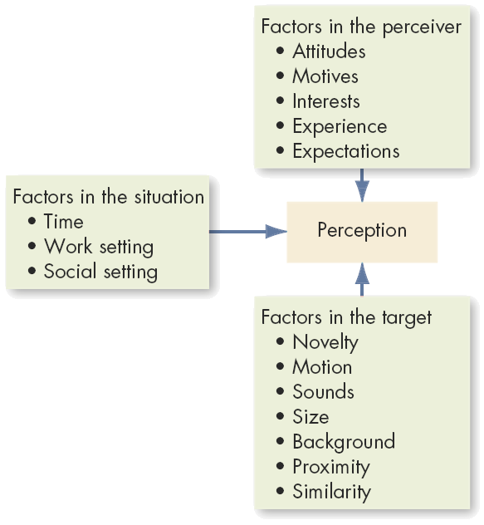
Factors that Influence Perception
See E X H I B I T 5-1
© 2009 Prentice-Hall Inc. All rights reserved.
5-<number>

Slide 5
Attribution Theory: Judging Others
Our perception and judgment of others is significantly influenced by our assumptions of the other person’s internal state.
  When individuals observe behavior, they attempt to determine whether it is internally or externally caused.
    Internal causes are under that person’s control
    External causes are not – person forced to act in that way
Causation judged through:
  Distinctiveness
    Shows different behaviors in different situations.
  Consensus
    Response is the same as others to same situation.
  Consistency
    Responds in the same way over time.
© 2009 Prentice-Hall Inc. All rights reserved.
5-<number>

Slide 6
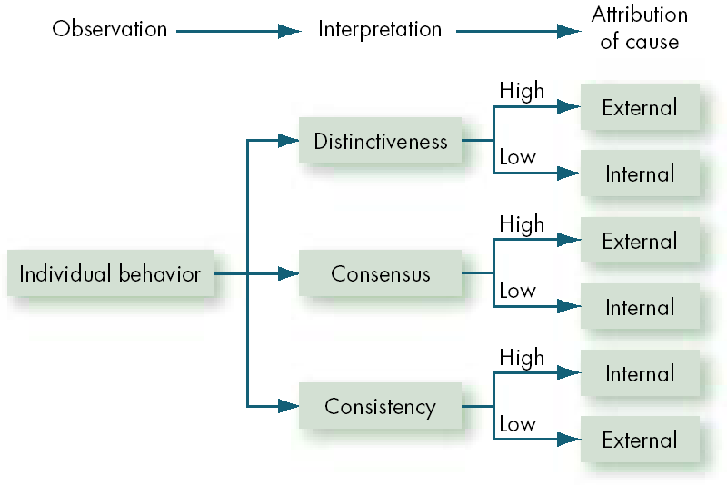
Elements of Attribution Theory
See E X H I B I T 5-2
© 2009 Prentice-Hall Inc. All rights reserved.
5-<number>

Slide 7

Errors and Biases in Attributions
Fundamental Attribution Error
  The tendency to underestimate the influence of external factors and overestimate the influence of internal factors when making judgments about the behavior of others
  We blame people first, not the situation
Self-Serving Bias
  The tendency for individuals to attribute their own successes to internal factors while putting the blame for failures on external factors
  It is “our” success but “their” failure
© 2009 Prentice-Hall Inc. All rights reserved.
5-<number>

Slide 8


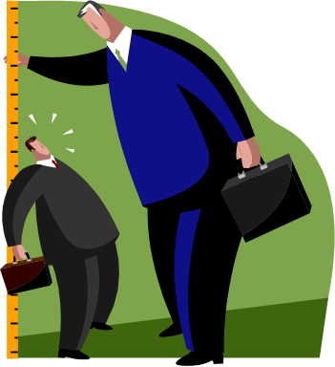
Frequently Used Shortcuts in Judging Others
Selective Perception
  People selectively interpret what they see on the basis of their interests, background, experience, and attitudes
Halo Effect
  Drawing a general impression about an individual on the basis of a single characteristic
Contrast Effects
  Evaluation of a person’s characteristics that are affected by comparisons with other people recently encountered who rank higher or lower on the same characteristics
© 2009 Prentice-Hall Inc. All rights reserved.
5-<number>

Slide 9

Another Shortcut: Stereotyping
Judging someone on the basis of one’s perception of the group to which that person belongs – a prevalent and often useful, if not always accurate, generalization
Profiling
  A form of stereotyping in which members of a group are singled out for intense scrutiny based on a single, often racial, trait.
© 2009 Prentice-Hall Inc. All rights reserved.
5-<number>

Slide 10
Specific Shortcut Applications in Organizations
Employment Interview
  Perceptual biases of raters affect the accuracy of interviewers’ judgments of applicants
  Formed in a single glance – 1/10 of a second!
Performance Expectations
  Self-fulfilling prophecy (Pygmalion effect): The lower or higher performance of employees reflects preconceived leader expectations about employee capabilities
Performance Evaluations
  Appraisals are often the subjective (judgmental) perceptions of appraisers of another employee’s job performance
  Critical impact on employees
© 2009 Prentice-Hall Inc. All rights reserved.
5-<number>

Slide 11

Perceptions and Individual Decision Making
Problem
  A perceived discrepancy between the current state of affairs and a desired state
Decisions
  Choices made from among alternatives developed from data
Perception Linkage:
  All elements of problem identification and the decision making process are influenced by perception.
    Problems must be recognized
    Data must be selected and evaluated
© 2009 Prentice-Hall Inc. All rights reserved.
5-<number>

Slide 12
Decision-Making Models in Organizations
Rational Decision-Making
  The “perfect world” model: assumes complete information, all options known, and maximum payoff.
  Six step decision-making process
Bounded Reality
  The “real world” model: seeks satisfactory and sufficient solutions from limited data and alternatives
Intuition
  A non-conscious process created from distilled experience that results in quick decisions
    Relies on holistic associations
    Affectively charged – engaging the emotions
See E X H I B I T 5-3
© 2009 Prentice-Hall Inc. All rights reserved.
5-<number>

Slide 13
Common Biases and Errors in Decision-Making
Overconfidence Bias
  Believing too much in our own ability to make good decisions – especially when outside of own expertise
Anchoring Bias
  Using early, first received information as the basis for making subsequent judgments
Confirmation Bias
  Selecting and using only facts that support our decision
Availability Bias
  Emphasizing information that is most readily at hand
    Recent
    Vivid
© 2009 Prentice-Hall Inc. All rights reserved.
5-<number>

Slide 14
More Common Decision-Making Errors
Escalation of Commitment
  Increasing commitment to a decision in spite of evidence that it is wrong – especially if responsible for the decision!
Randomness Error
  Creating meaning out of random events - superstitions
Winner’s Curse
  Highest bidder pays too much due to value overestimation
  Likelihood increases with the number of people in auction
Hindsight Bias
  After an outcome is already known, believing it could have been accurately predicted beforehand
© 2009 Prentice-Hall Inc. All rights reserved.
5-<number>

Slide 15
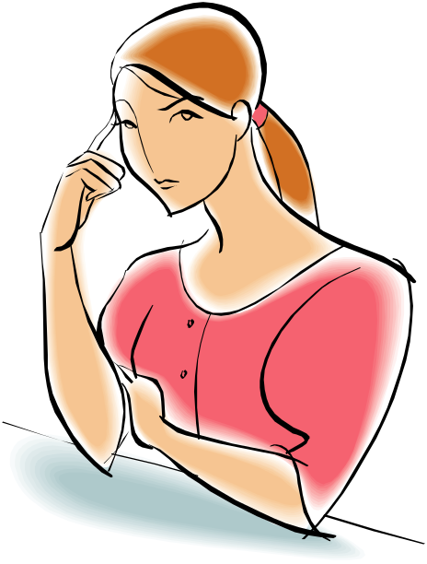
Individual Differences in Decision-Making
Personality
  Conscientiousness may effect escalation of commitment
    Achievement-strivers are likely to increase commitment
    Dutiful people are less like to have this bias
  Self-Esteem
    High self-esteem people are susceptible to self-serving bias
Gender
Women analyze decisions more than men – rumination
Women are twice as likely to develop depression
Differences develop early
© 2009 Prentice-Hall Inc. All rights reserved.
5-<number>

Slide 16
Organizational Constraints
Performance Evaluation
  Managerial evaluation criteria influence actions
Reward Systems
  Managers will make the decision with the greatest personal payoff for them
Formal Regulations
  Limit the alternative choices of decision makers
System-imposed Time Constraints
  Restrict ability to gather or evaluate information
Historical Precedents
  Past decisions influence current decisions
© 2009 Prentice-Hall Inc. All rights reserved.
5-<number>

Slide 17
Ethics in Decision Making
Ethical Decision Criteria
  Utilitarianism
    Decisions made based solely on the outcome
    Seeking the greatest good for the greatest number
    Dominant method for businesspeople
  Rights
    Decisions consistent with fundamental liberties and privileges
    Respecting and protecting basic rights of individuals such as whistleblowers
  Justice
    Imposing and enforcing rules fairly and impartially
    Equitable distribution of benefits and costs
© 2009 Prentice-Hall Inc. All rights reserved.
5-<number>

Slide 18

Ethical Decision-Making Criteria Assessed
Utilitarianism
  Pro: Promotes efficiency and productivity
  Con: Can ignore individual rights, especially minorities
Rights
  Pro: Protects individuals from harm; preserves rights
  Con: Creates an overly legalistic work environment
Justice
  Pro: Protects the interests of weaker members
  Con: Encourages a sense of entitlement
© 2009 Prentice-Hall Inc. All rights reserved.
5-<number>

Slide 19

Improving Creativity in Decision Making
Creativity
  The ability to produce novel and useful ideas
Who has the greatest creative potential?
  Those who score high in Openness to Experience
  People who are intelligent, independent, self-confident, risk-taking, have an internal locus-of-control, tolerant of ambiguity, low need for structure, and who persevere in the face of frustration
© 2009 Prentice-Hall Inc. All rights reserved.
5-<number>

Slide 20
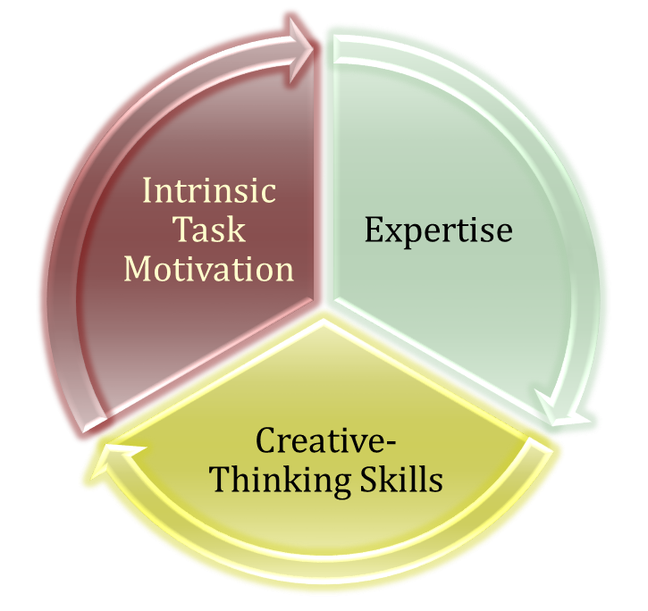
The Three Component Model of Creativity
Proposition that individual creativity results from a mixture of three components
  Expertise is the foundation
  Creative-Thinking Skills are the personality characteristics associated with creativity
  Intrinsic Task Motivation is the desire to do the job because of its characteristics
See E X H I B I T 5-4
© 2009 Prentice-Hall Inc. All rights reserved.
5-<number>

Slide 21

Global Implications
Attributions
  There are cultural differences in the ways people attribute cause to observed behavior
Decision-Making
  No research on the topic: assumption of “no difference”
  Based on our awareness of cultural differences in traits that affect decision making, this assumption is suspect
Ethics
  No global ethical standards exist
  Asian countries tend not to see ethical issues in “black and white” but as shades of gray
  Global companies need global standards for managers
© 2009 Prentice-Hall Inc. All rights reserved.
5-<number>

Slide 22
Summary and Managerial Implications
Perception:
  People act based on how they view their world
  What exists is not as important as what is believed
  Managers must also manage perception
Individual Decision Making
  Most use bounded rationality: they satisfice
  Combine traditional methods with intuition and creativity for better decisions
    Analyze the situation and adjust to culture and organizational reward criteria
    Be aware of, and minimize, biases
© 2009 Prentice-Hall Inc. All rights reserved.
5-<number>

Slide 23

All rights reserved. No part of this publication may be reproduced, stored in a retrieval system, or transmitted, in any form or by any means, electronic, mechanical, photocopying, recording, or otherwise, without the prior written permission of the publisher. Printed in the United States of America.
Copyright ©2009 Pearson Education, Inc. Publishing as Prentice Hall

